Slide 1

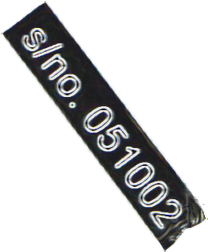
Design and Development of Machine Learning Frameworks for Fake News Detection
2023 /
Kevin Wang

Slide 2
Reseach Quesitons
What is the comparative effectiveness of different machine learning models and feature extraction methods in detecting fake news?
What is the potential of transfer and incremental learning in improving the efficiency of fake news detection?
What are the ethical considerations and implications of using machine learning for fake news detection?
/

Slide 3
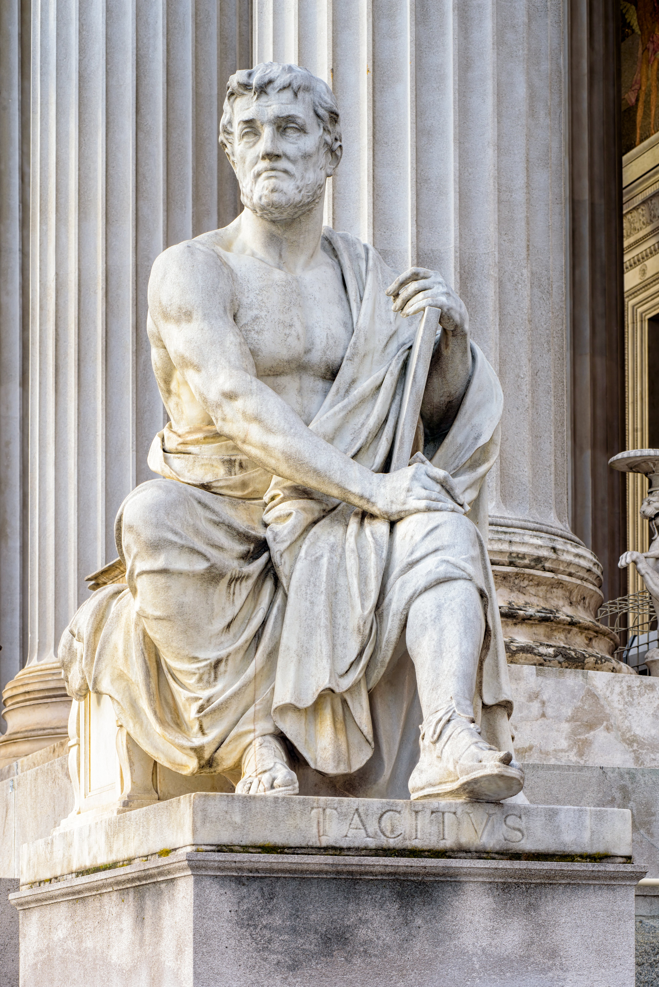
TACITUS TRAP
When a ruler once becomes unpopular, all his acts, be they good or bad, tell against him.

Slide 4
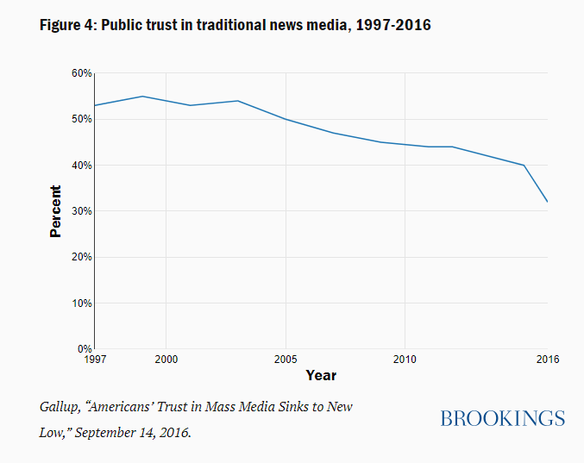

Slide 5
/
Existing
Research
/
Difference
Comparing ML Models
Khan et al.
Albahr et al.
The Use of Naive Bayes Classifiers for Fake News Detection
Hassan et al.
Mandical et al.
The Use of Transfer and Incremental Learning with NB Classifiers
Do et al.
Werner et al.
Metsis et al.
Implementation of a User-Friendly framework
Comparison between TF-IDF, Empath and the Hybrid approach
Exploration of Transfer and Incremental Learning in the field of fake news detection

Slide 6
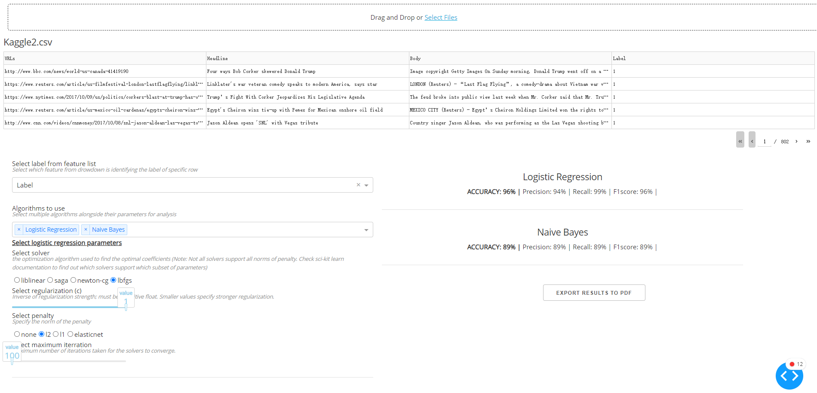

Slide 7
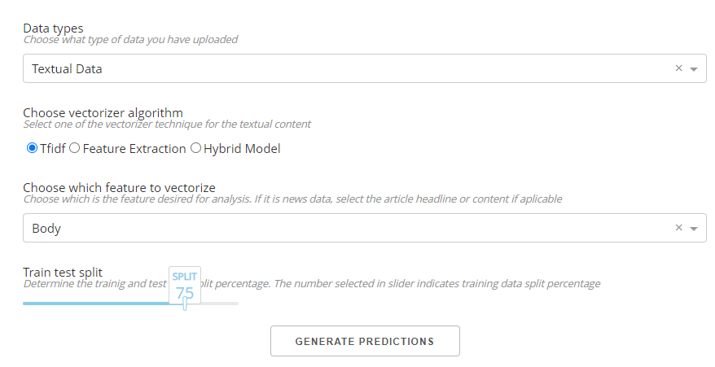

Slide 8
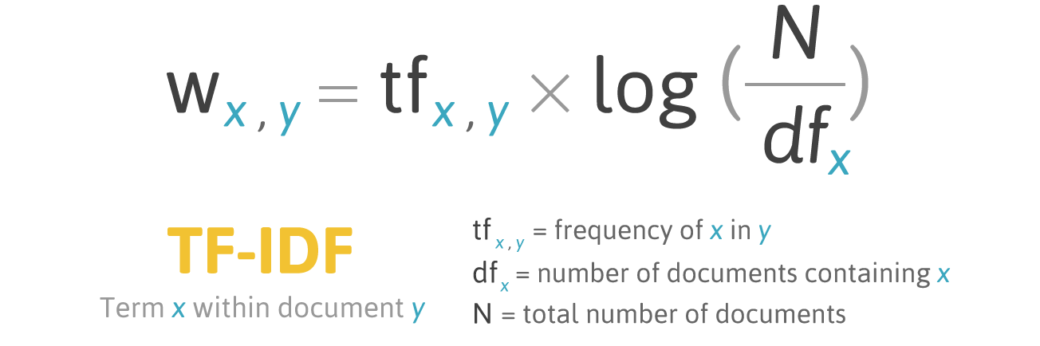
TF-IDF
and Empath
/

Slide 9
The Hybrid
Approach
Compute TF-IDF vectors
Generate Empath features
Combine the vectors
/

Slide 10
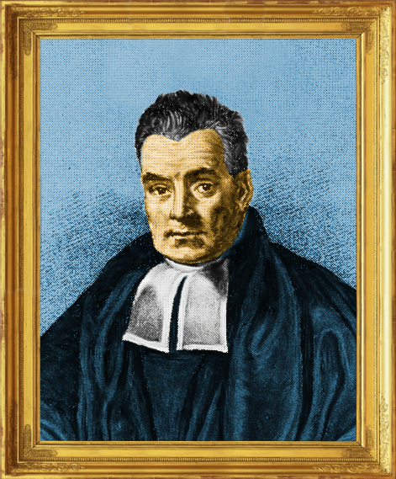
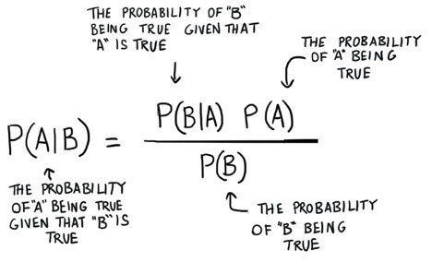
Naive
Bayes
/

Slide 11
Naive
Bayes
Gaussian Bayes
Categorical Naive Bayes
Multinomial Naive Bayes
Bernoulli Naive Bayes
/

Slide 12
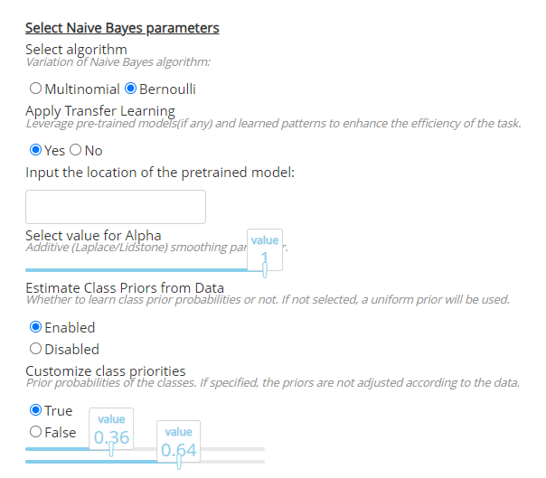
Naive
Bayes
Parameters
/

Slide 13
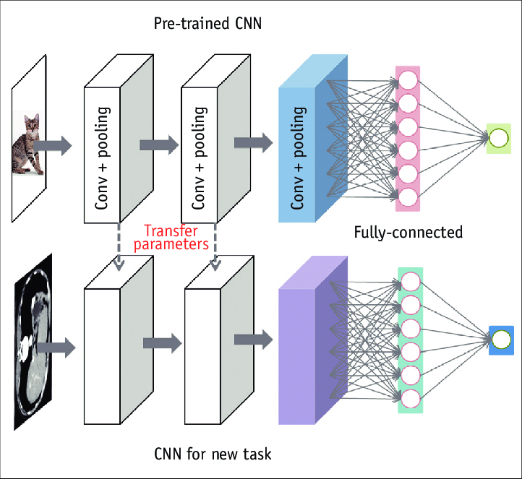
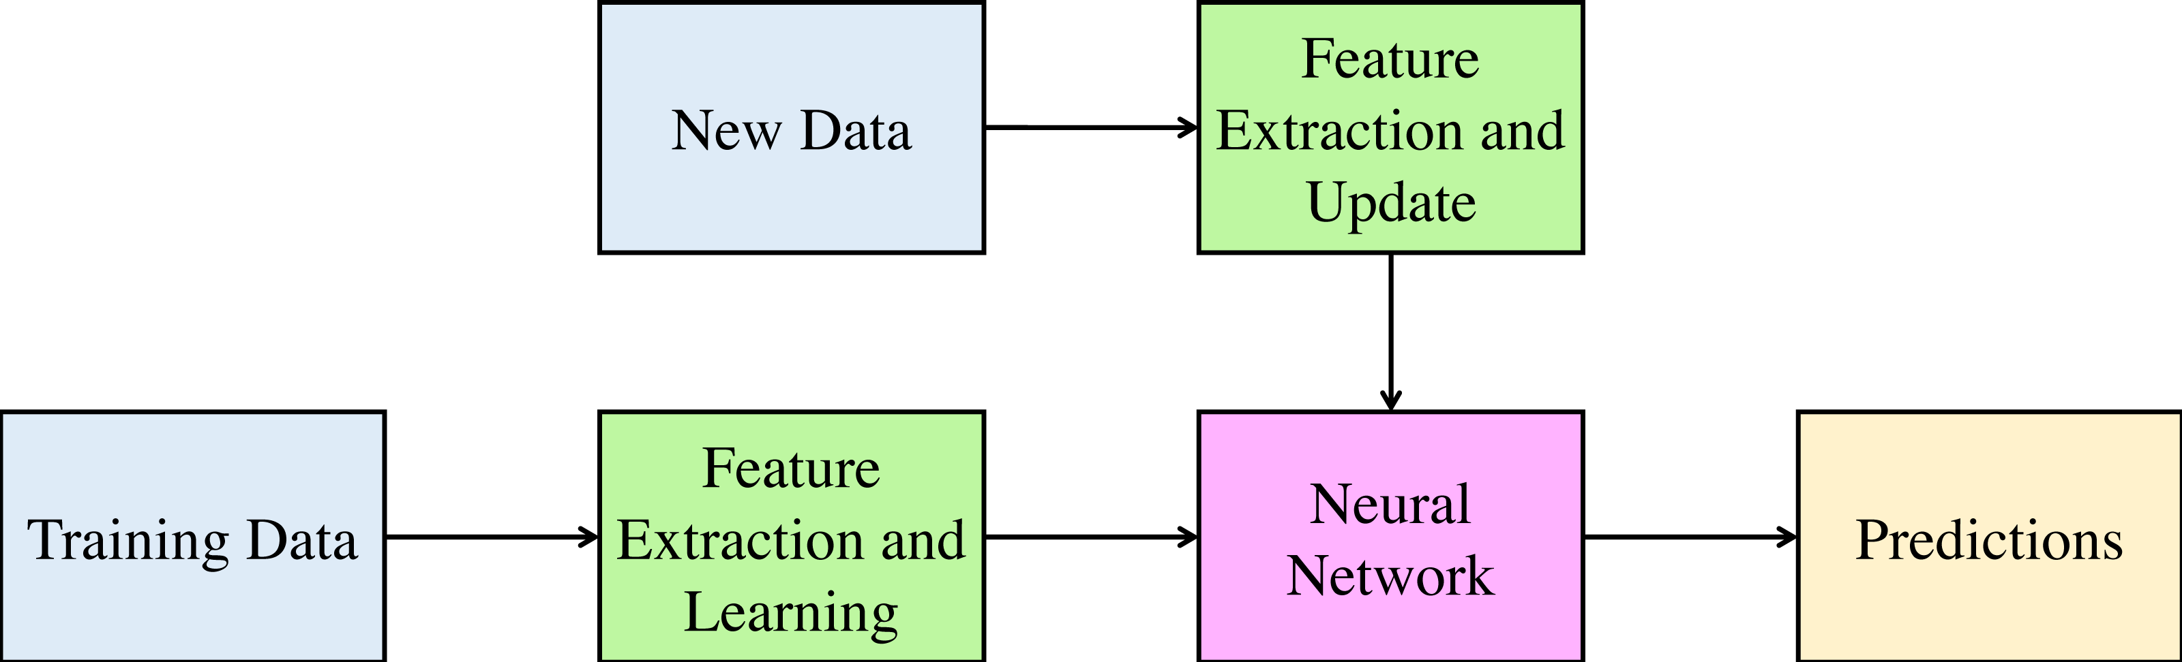
2023 /
Transfer and Incremental Learning

Slide 14
Experiments
Setup
Scraped dataset - 50000
FA-KES - syrian war dataset - 804
Merged dataset - 10000
Dataset 1 from Kaggle - 20387
Dataset 2 from Kaggle - 3352
WELFake - 72134
 | Predicted: True | Predicted: False
Actual: True | True Positive (TP) | False Negative (FN)
Actual: False | False Positive (FP) | True Negative (TN)
Accuracy = (TP + TN) / (TP + TN + FP + FN)
Precision = TP / (TP + FP)
Recall = TP / (TP + FN)
F1 score = 2 * (Precision * Recall) / (Precision + Recall)
/

Slide 15
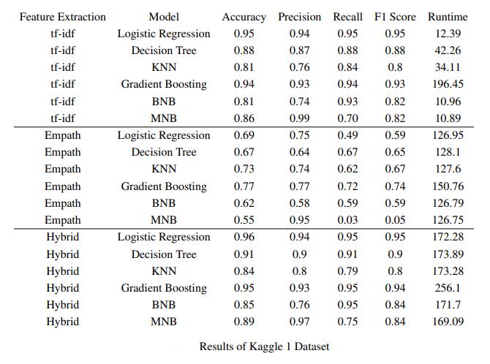
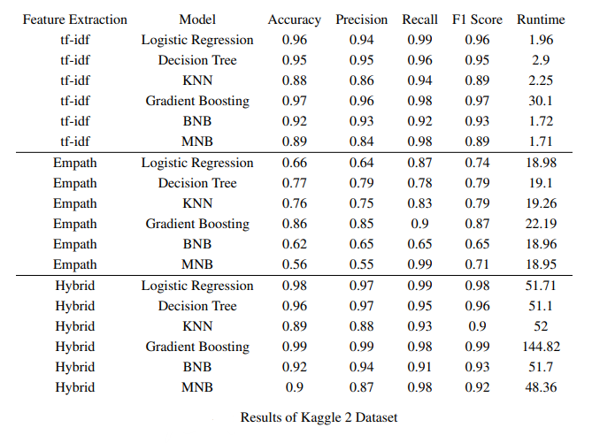
/
RESULTS

Slide 16
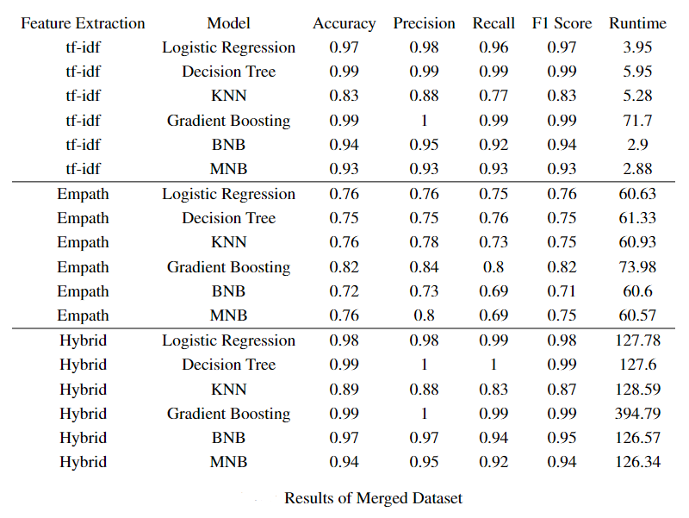
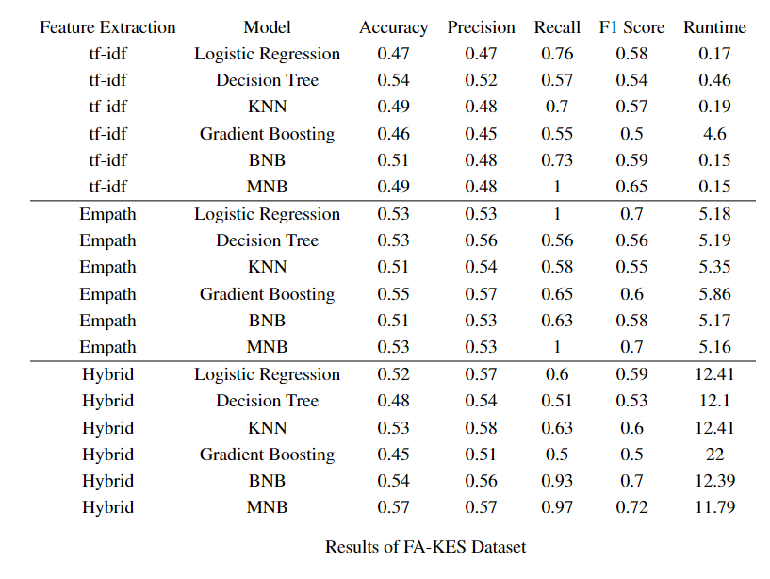
/
RESULTS

Slide 17
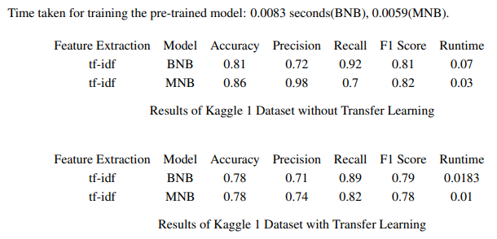
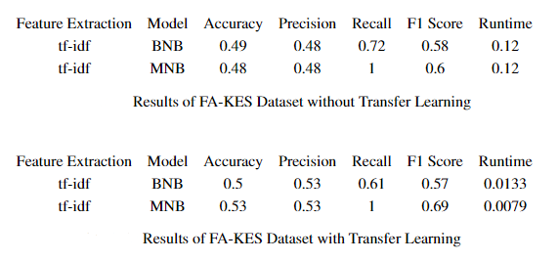
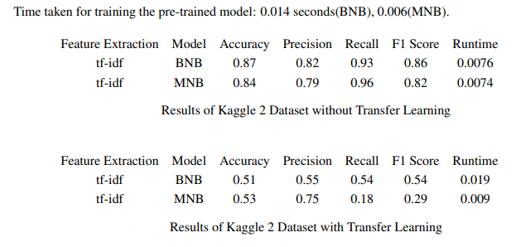
Pre-training on Kaggle 2 for Testing on Kaggle 1
Pre-training on Kaggle 2 for Testing on FA-KES
/
RESULTS
Pre-training on Trimmed-Kaggle 1 for Testing on Kaggle 2

Slide 18
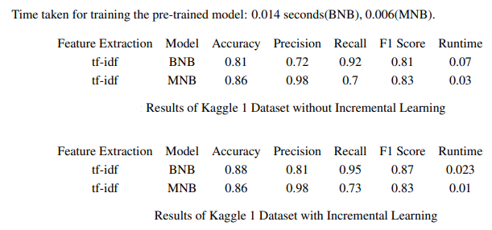
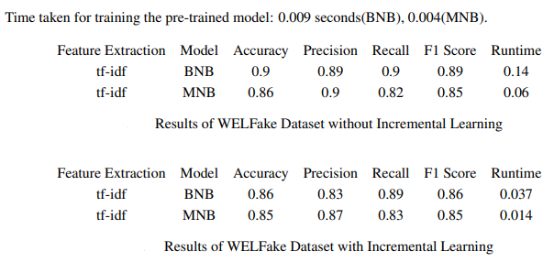
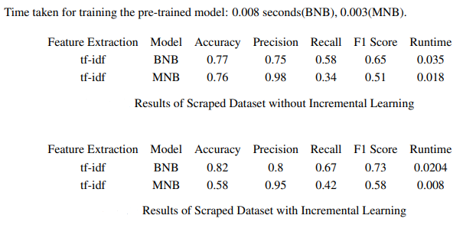
/
RESULTS

Slide 19

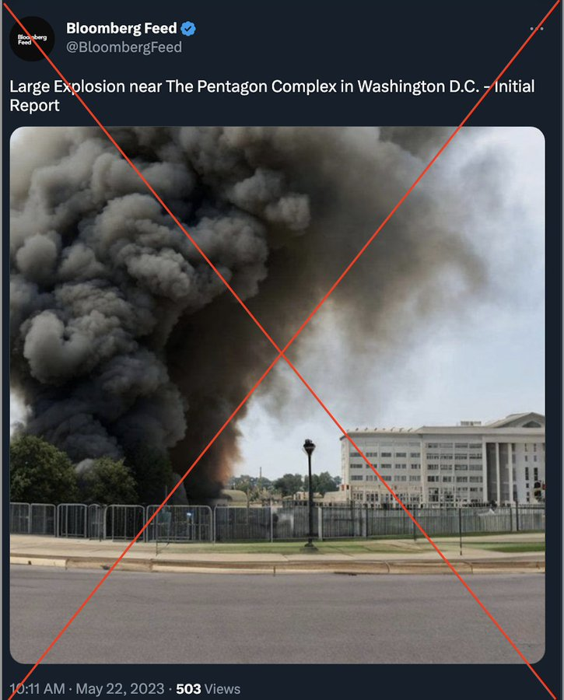
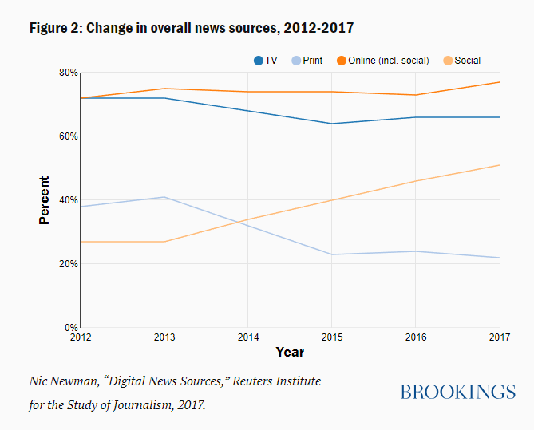
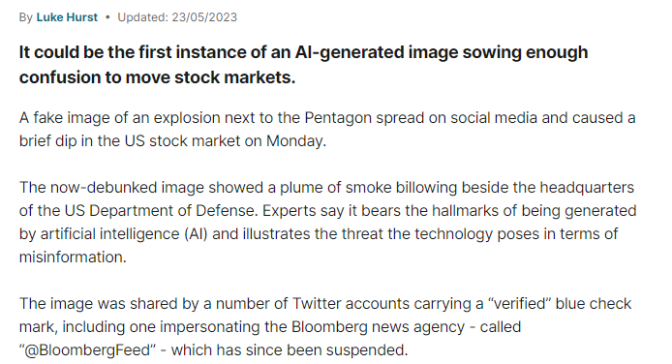
/
Ethical
Consideration
Unclear Standard of Fake News
Decentralization Source of Information
Press Freedom
The Misuse of AI

Slide 20
/
Limitations and
Future Directions
Language Limitations
Binary Classification
Lack of Data Diversity
Runtime and Computational Resources
Refining Transfer Learning
Refining Incremental Learning
Addition of New Machine Learning and Deep Learning Models

Slide 21
/
Main
Contributions
Integration of Additional Machine Learning Libraries
Enhanced User Control
Investigation of Transfer Learning
Exploration of Incremental Learning
Empirical Evaluation Across Datasets

Slide 22
Design and Development of Machine Learning Frameworks for Fake News Detection
2023 /
Kevin Wang
Thank You for Listening

